Slide 1
Unit Testing in AngularJS
Alex Wong

Slide 2
Section A: Unit Testing Overview
http://notafraidofwong.blogspot.com/search/label/Unit%20Testing

Slide 3
Getting Started
http://notafraidofwong.blogspot.com/2018/07/unit-testing.html

Slide 4
Section B: Unit Testing Deep Dive

Slide 5
How to actually Unit Test? Stubs, Mocks.etc
http://notafraidofwong.blogspot.com/2018/07/unit-testing-test-doubles-stubs-mocksetc.html

Slide 6
Section C: AngularJS Unit Testing Framework - Karma

Slide 7

Karma
Quoting from Karma website (https://karma-runner.github.io/latest/index.html)
“On the AngularJS team, we rely on testing and we always seek better tools to make our life easier. That's why we created Karma - a test runner that fits all our needs.”
A tool which spawns a web server for users to test their JavaScript source code.
More info at https://karma-runner.github.io/3.0/intro/how-it-works.html

Slide 8
How Karma works?
Starts local web server and starts one or more browsers.
Karma instructs client (with hosted js via web server) to execute tests.
The result of the test is reported back to the server via websockets.
Reporters listen on ws messages and process it
It may print, save to file or forward data to another server.
Main karma reporter is Jasmine.
Note that Karma has many variations and options that may cause different workflow with different configurations.
More detailed steps are in https://karma-runner.github.io/3.0/intro/how-it-works.html

Slide 9

What is Jasmine?
Jasmine is a Behavior Driven Development testing framework for JavaScript.
It does not rely on browsers, DOM, or any JavaScript framework. Thus it's suited for websites, Node.js projects, or anywhere that JavaScript can run.
More info in https://github.com/jasmine/jasmine

Slide 10


Karma vs Jasmine
If you only had Jasmine (or Mocha), you are running all your code with the Node virtual Machine.
Adding Karma to the mix will run your test suite with the engine of other browsers.
By doing this, you get are testing more closely with the browser environment. It will also be easier to test DOM related code.
Source: https://stackoverflow.com/questions/26032124/karma-vs-testing-framework-jasmine-mocha-qunit

Slide 11
Executing Karma Unit Tests
You must have karma-cli installed.
You can do that via “npm install –g karma-cli”
You need to have some karma unit testing source code
I already wrote this. To find this: ~/webui/test/unit

Slide 12
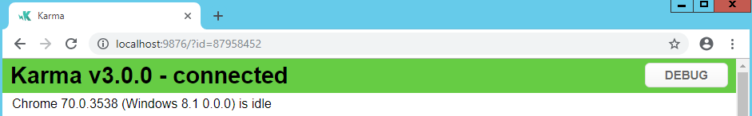
Executing Karma Unit Tests
To run this:
Open unit test source code in terminal.
Run ‘npm install’
Run ‘karma start’
If your karma’s browser setting is set to ‘Chrome’, you will see this pop up.

Slide 13
Karma plugins: Karma-coverage
A karma plugin. Generate code coverage.
Behind the scenes, it uses Istanbul, a comprehensive JavaScript code coverage tool.
In karma.conf.js, these are the important configurations:
reporters: ['progress', 'coverage'], coverageReporter: { type : 'html', dir : 'test/unit/coverage/' // output destination folder for coverage report. },
More info: https://github.com/karma-runner/karma-coverage

Slide 14
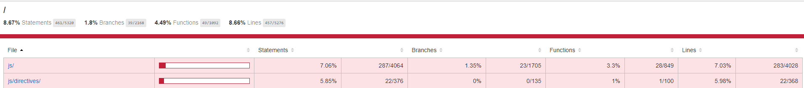
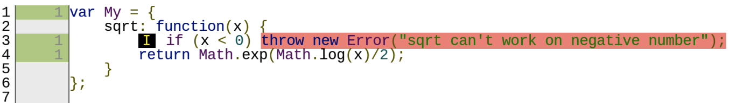
Karma plugins: Karma-coverage
Example:
First screenshot displays code coverage by folder.
Second screenshot displays code coverage per script. (Line coverage)
Red is untouched. Not red
More info: https://github.com/karma-runner/karma-coverage

Slide 15
Coverage
There are several types of coverages; in karma-coverage, we have 4.
Line Coverage
Statement Coverage
Branch Coverage
Sometimes, your code can branch into different possibilities; such as using an if-else statement.
Branch coverage measures how much of the branches are tested/executed
Function Coverage

Slide 16
Junit Report (Karma-junit-reporter)
A Karma plugin. Report results in junit xml format.
Reason we need this is to integrate to Jenkins workflow. (explained in next slide)
More info: https://github.com/karma-runner/karma-junit-reporter

Slide 17

Jenkins Integration
Jenkins CI is one of the most popular continuous integration servers.
To integrate with Karma, karma needs to export a Junit test result report and let Jenkins access it.
To Configure Karma to export Junit test result.
Make sure karma-junit-reporter is installed.
Make following changes to your karma.conf.js file:
singleRun: true, reporters: ['dots', 'junit'], junitReporter: { outputFile: 'test-results.xml' },
Should configure outputFile to your preferred destination.
More instructions: http://karma-runner.github.io/3.0/plus/jenkins.html

Slide 18
Section D: Jasmine Specs (test cases)

Slide 19
Notes on Jasmine
Basic Jasmine walkthrough:
https://jasmine.github.io/tutorials/your_first_suite
Jasmine Style Guide
https://github.com/CareMessagePlatform/jasmine-styleguide#speak-human
Demo:
karma.conf.js walkthrough
Files
Browser – headless option
loadDetailsErrorController.spec.js
Setting up service, factory, controller
Talk about issues I found in my own code.
$scope.onUpdateErrType
Promises

Slide 20
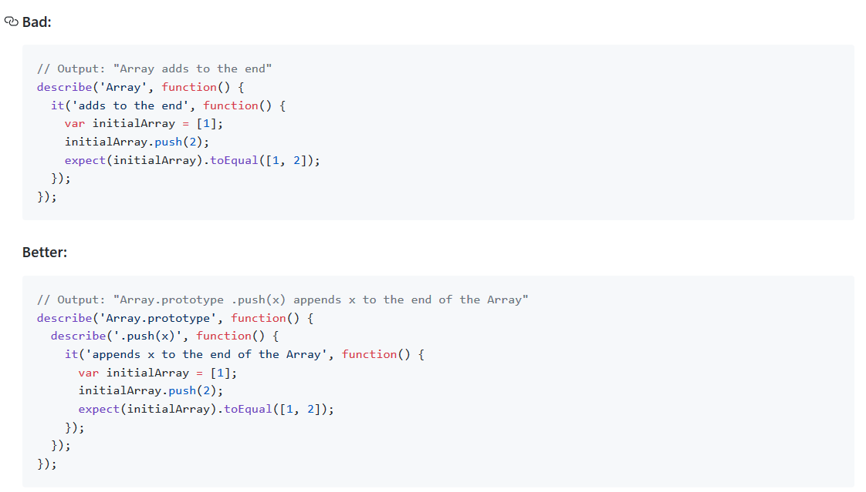
Notes on Jasmine
Naming Conventions
Source: https://github.com/CareMessagePlatform/jasmine-styleguide#speak-human

Slide 21
Section E: Best Practices

Slide 22
http://notafraidofwong.blogspot.com/2018/08/best-practices-of-unit-testing.html
http://notafraidofwong.blogspot.com/2018/08/unit-testing-unit-test-as-bug-report.html

